Slide 1

Face Recognition End Term Presentation - Minor Project
Presented By
Rishabh Mathur 189302130
Ishan Shrimali 189302113
Project Guide
Mr. Deevesh Chaudhary
Assistant Professor , IT Department , SCIT
Manipal University Jaipur

Slide 2
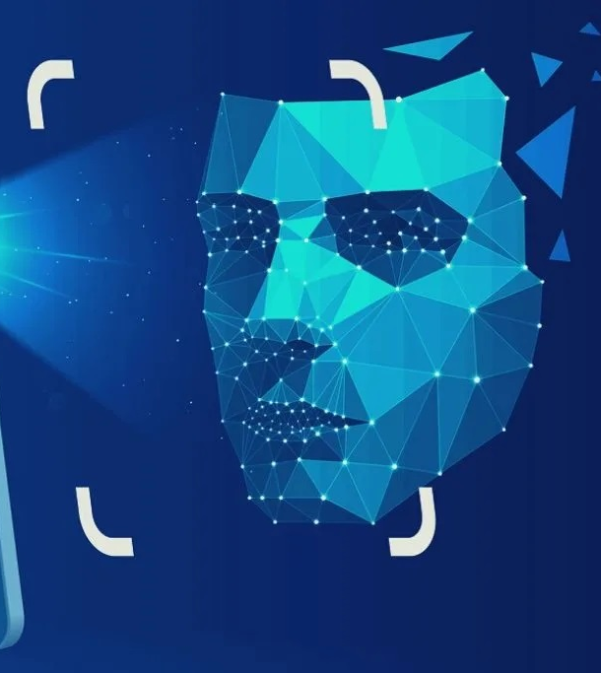
Introduction
Face recognition is one of the challenging tasks in computer vision research area. It is method of identifying or verifying the identity of individual using their faces. Provided with number of facial images, a machine learning model needs to be trained that detects faces with an acceptable accuracy level.
Face recognition is one of the many wonders that AI research has brought forward to the world. It is a subject of curiosity for many, who would like to have a basic understanding of how things work.
The main question lies now that how do we recognize a face?
Most images of human faces have two eyes, a nose, lips, forehead, chin, ears, hair and that rarely changes. Yet, faces are different from each other.
What makes them different? At the same time, face of the same person changes with emotion, expression. , age. In fact just a minor change in orientation creates a different image.

Slide 3
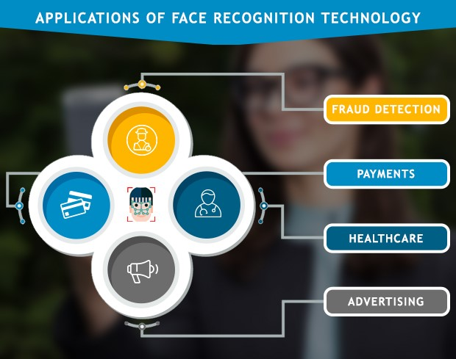
Motivation
Face recognition task is majorly useful for security purposes to detect and avoid any crime. It is also useful for authorized access at private places combined with other biometric technologies such as fingerprints and retina scanner.
Face recognition is currently being used to instantly identify when known shoplifters, organized retail criminals or people with a history of fraud enter retail establishments. Photographs of individuals can be matched against large databases of criminals so that loss prevention and retail security professionals can be instantly notified when a shopper enters a store that prevents a threat.
In addition to making schools safer, face recognition has the potential to track students’ attendance. Traditionally, attendance sheets can allow students to sign another student, who is ditching class, in. Many countries already using face recognition to ensure students aren’t skipping class. Tablets are being used to scan students’ faces and match their photos against a database to validate their identities.
The vast areas where face recognition find it’s applications today motivated us to take up this project.

Slide 4
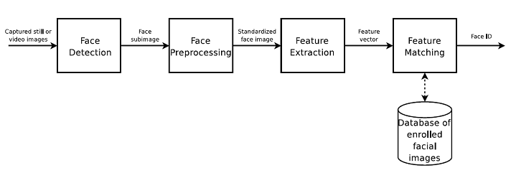
Work Flow
Face detection → Feature Extraction → Face Representation → Face Matching

Slide 5
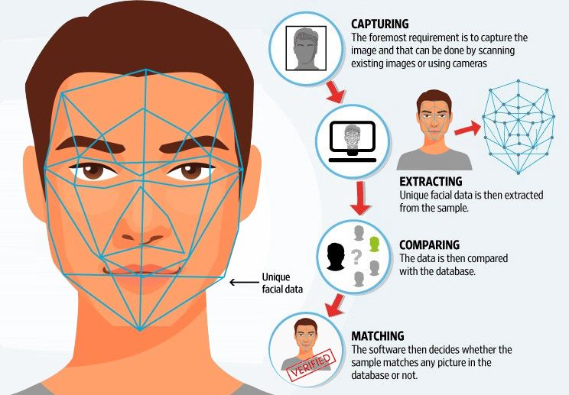
Face Detection
The facial recognition process starts with the human face and the necessary facial features pattern of the person to be identified.
Facial recognition technology also needs to learn what a face is and how it looks. This is done by using deep neural network & machine learning algorithms on a large database of images with human faces looking at different angles or positions.

Slide 6
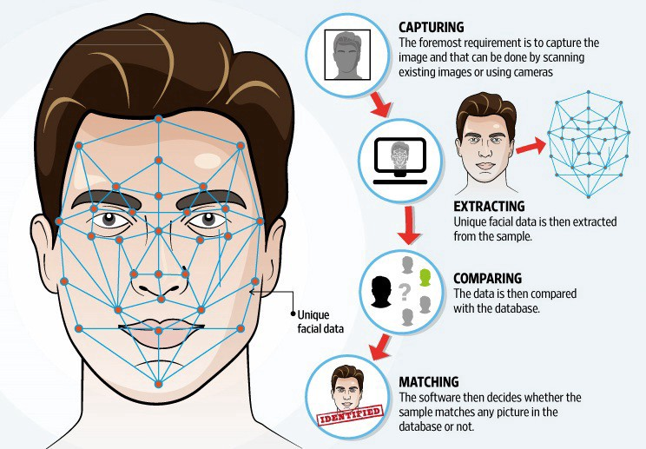
Feature Extraction
Once the face is detected, the software is trained with the help of computer vision algorithms to detect the facial landmarks (eyebrow corners, eyes gap, tip of the nose, mouth corners, etc.) Each landmark is considered as nodal points, and each face has approximately 80 nodal points. These landmarks are the key to distinguish each face present in the database.
After this, the registered face in the database is adjusted in position, size and scale to match with user’s face. It would help whenever the user’s face moves or expression changes; the software will accurately recognize it.

Slide 7
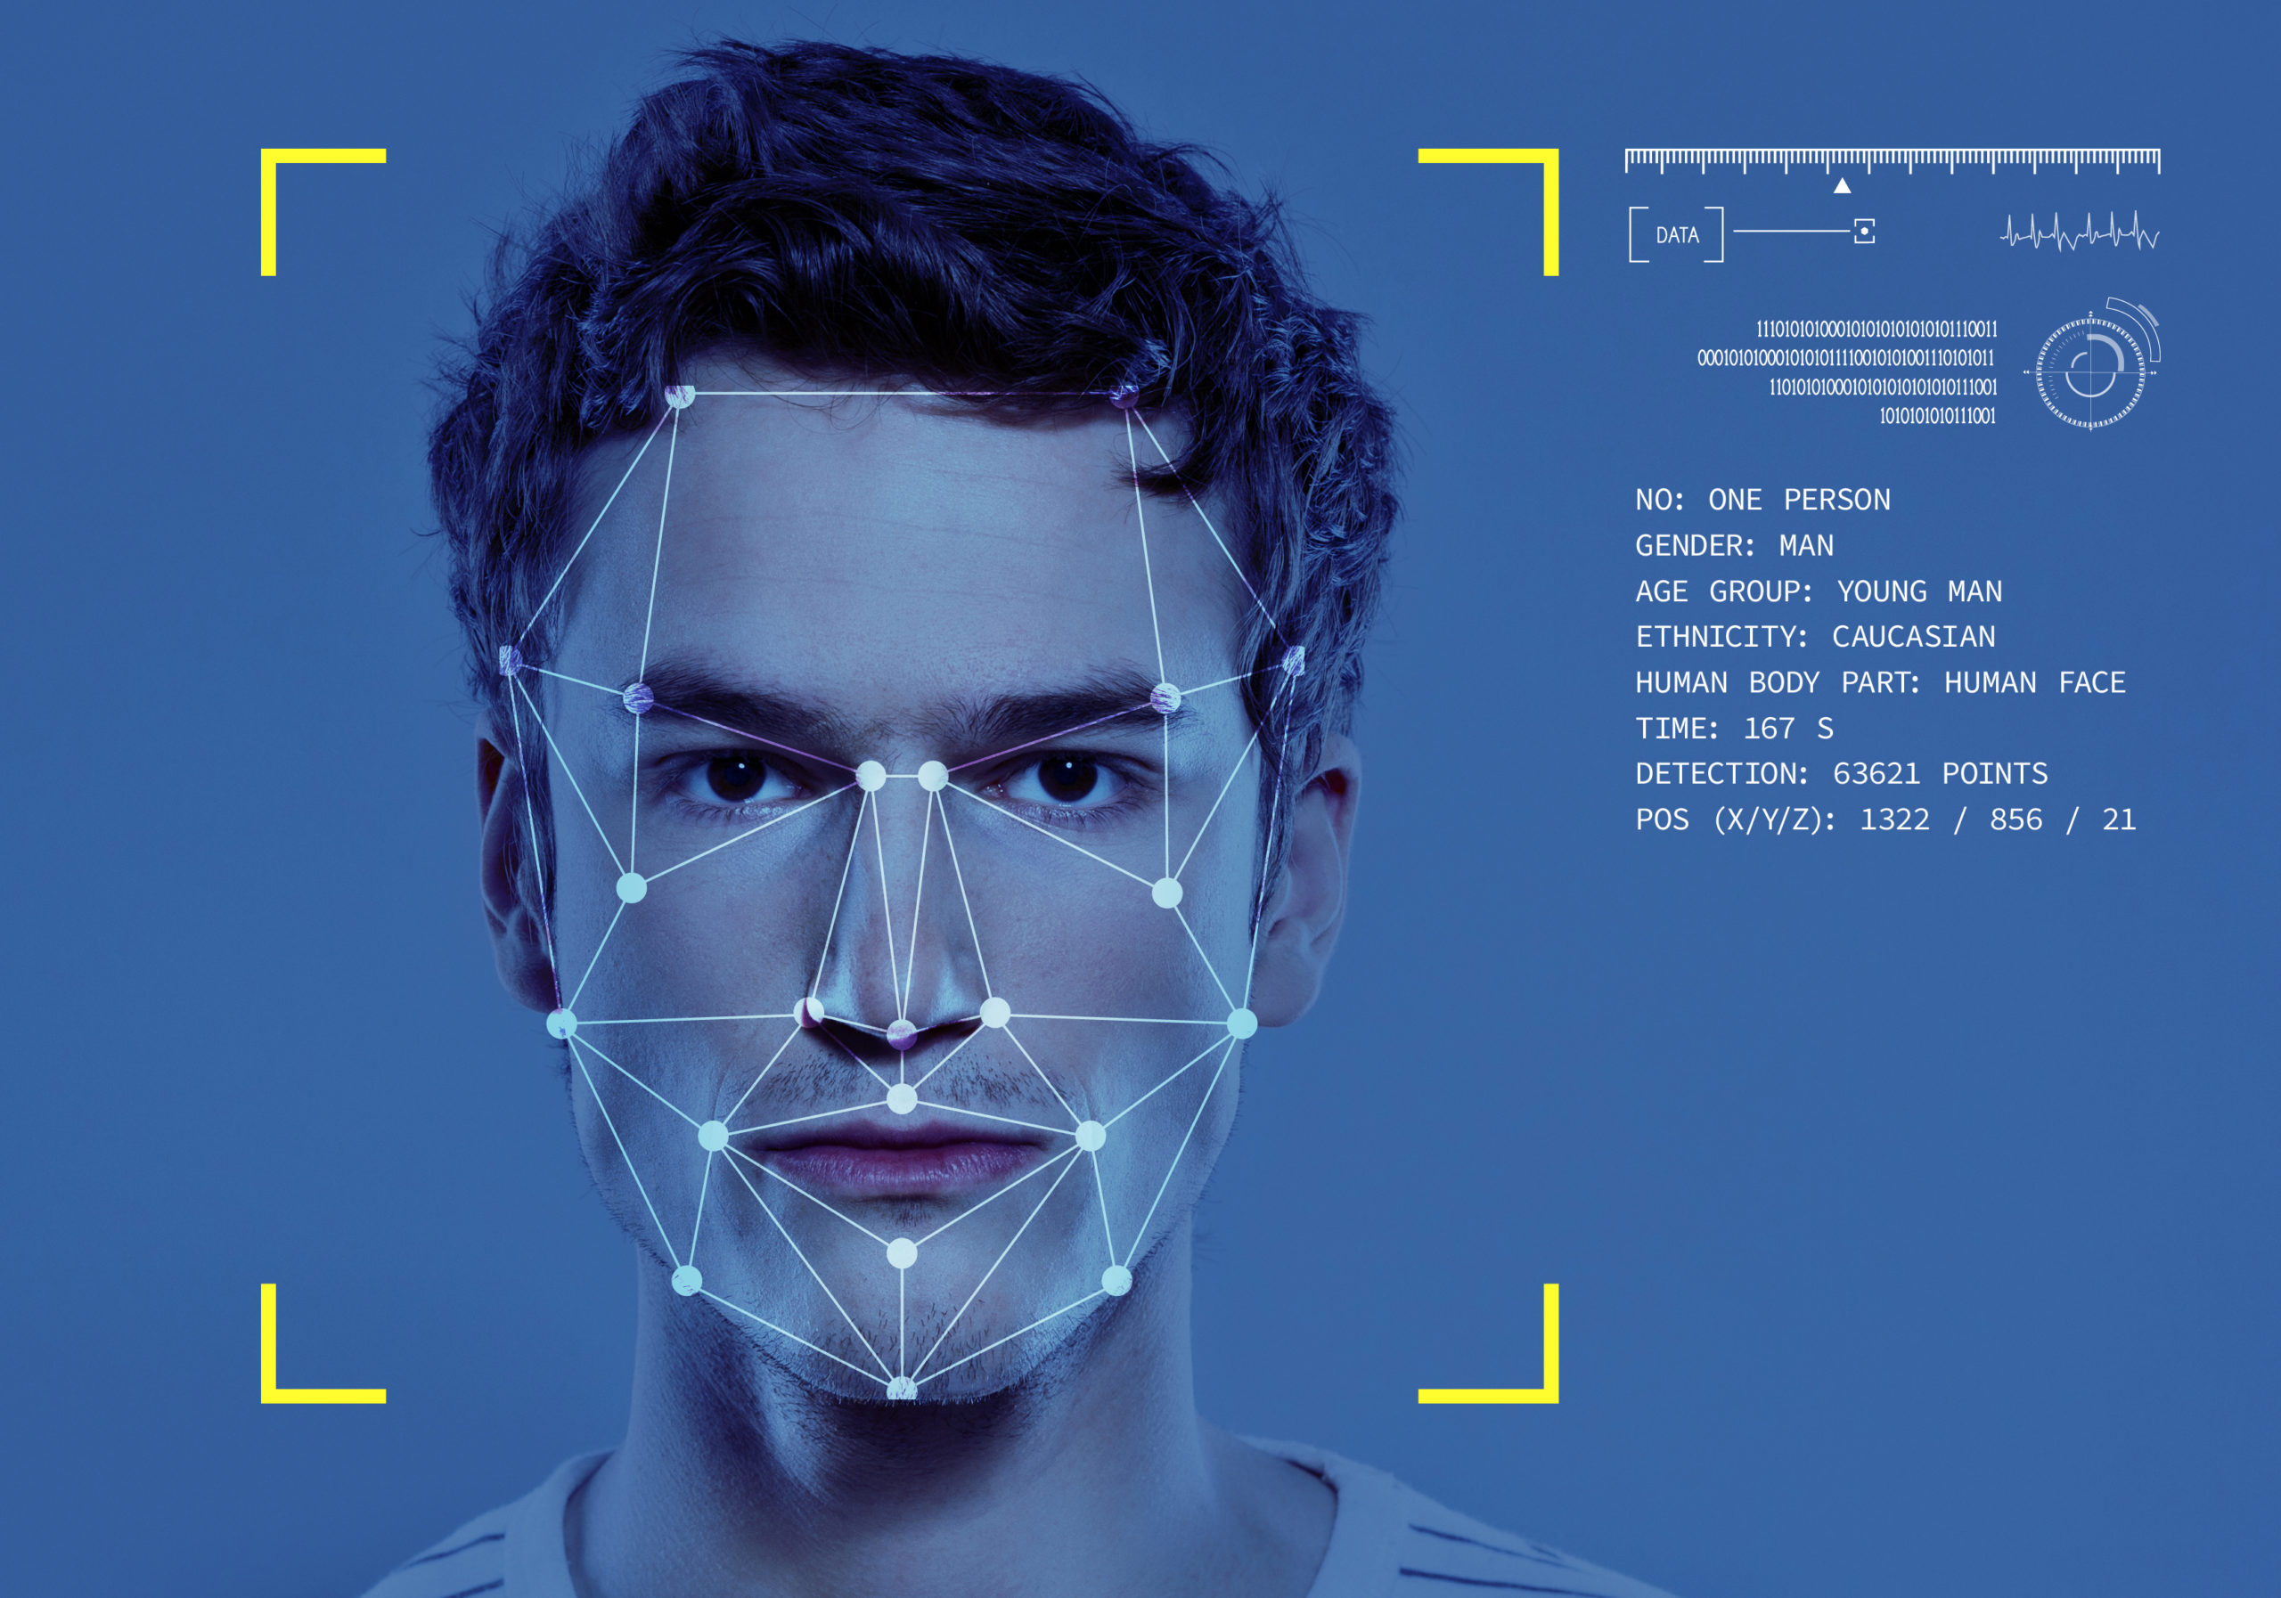
Face Representation
When the facial feature is extracted, and landmarks, face position, orientation & all key elements are fed into the software, the software generates a unique feature vector for each face in the numeric form.
These numeric codes are also called Faceprint, similar to Fingerprint in contact biometric system. Each code uniquely identifies the person among all the others in the training dataset.

Slide 8
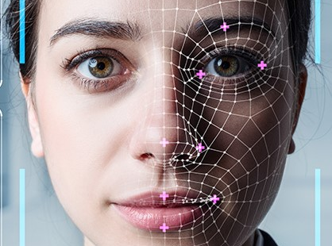
Face matching
→ After generating the unique vector code, it is compared against the faces in the database. The database has all the information of registered users. If the software identifies the match for exact feature in the database, it provides all the person’s details.
→ If the compared featured vector value is below a certain threshold value, the feature-based classifier returns the id of the match found in the database . There are some challenges while performing the face matching process.

Slide 9

What’s unique about our project??
Since we know, that already a lot of work has been done in the field of face recognition, we wanted to do something new, therefore we integrated real time mask detection with our project.
In this, we capture the images in real time and detect whether they are with or without mask.

Slide 10
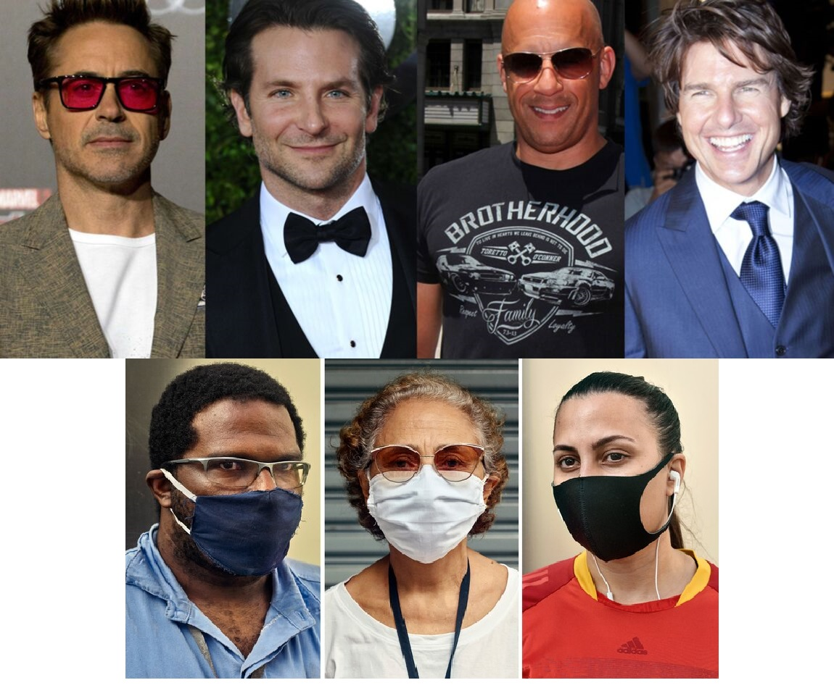
How It works..
When we run the detect Mask Web cam code, The image captured in the real time will be saved in a new folder for that date itself which contains all the captures of that day.
This is a continuous process.
At real time image is captured and saved in directory for further processing..
Input Image →

Slide 11
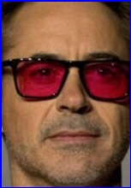

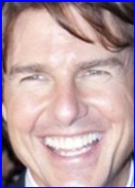
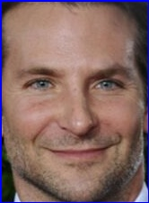
Once the image is saved, we trigger the next program image mask detection using the keys, which program will then find the images from the folder of the given day and then it will analyse all the images, whether they are with mask or without mask and save it to a new designated folder, capture where it will save the images date wise alongside a counter which shows the no. of people with or without mask.
The images from the capture folder will now take into consideration all the images which are without mask and put it in a new folder and save the already cropped the faces separately for future purposes.

Slide 12
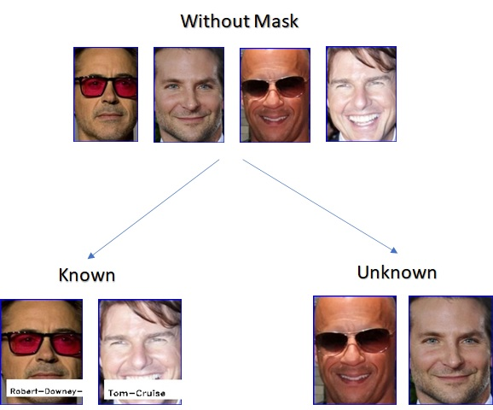
Face Recognition model will then trace back to the no mask std folder where it will recognise the photos of the student dataset which already contains the photos of the students and then it will recognise and put the students with their name in a new csv file.
Now the person without a mask will be further divided into 2 different categories – Known and Unknown. The once who are in the dataset, will be put in the known folder and those are neither wearing a mask nor are in the dataset, they would be put in the unknown category and their images would be popped on the screen.
Also the person with mask will be saved in a separate csv file with the no. of count
We have tried to explain the entire process in the form of a flow chart for better understanding…..

Slide 13
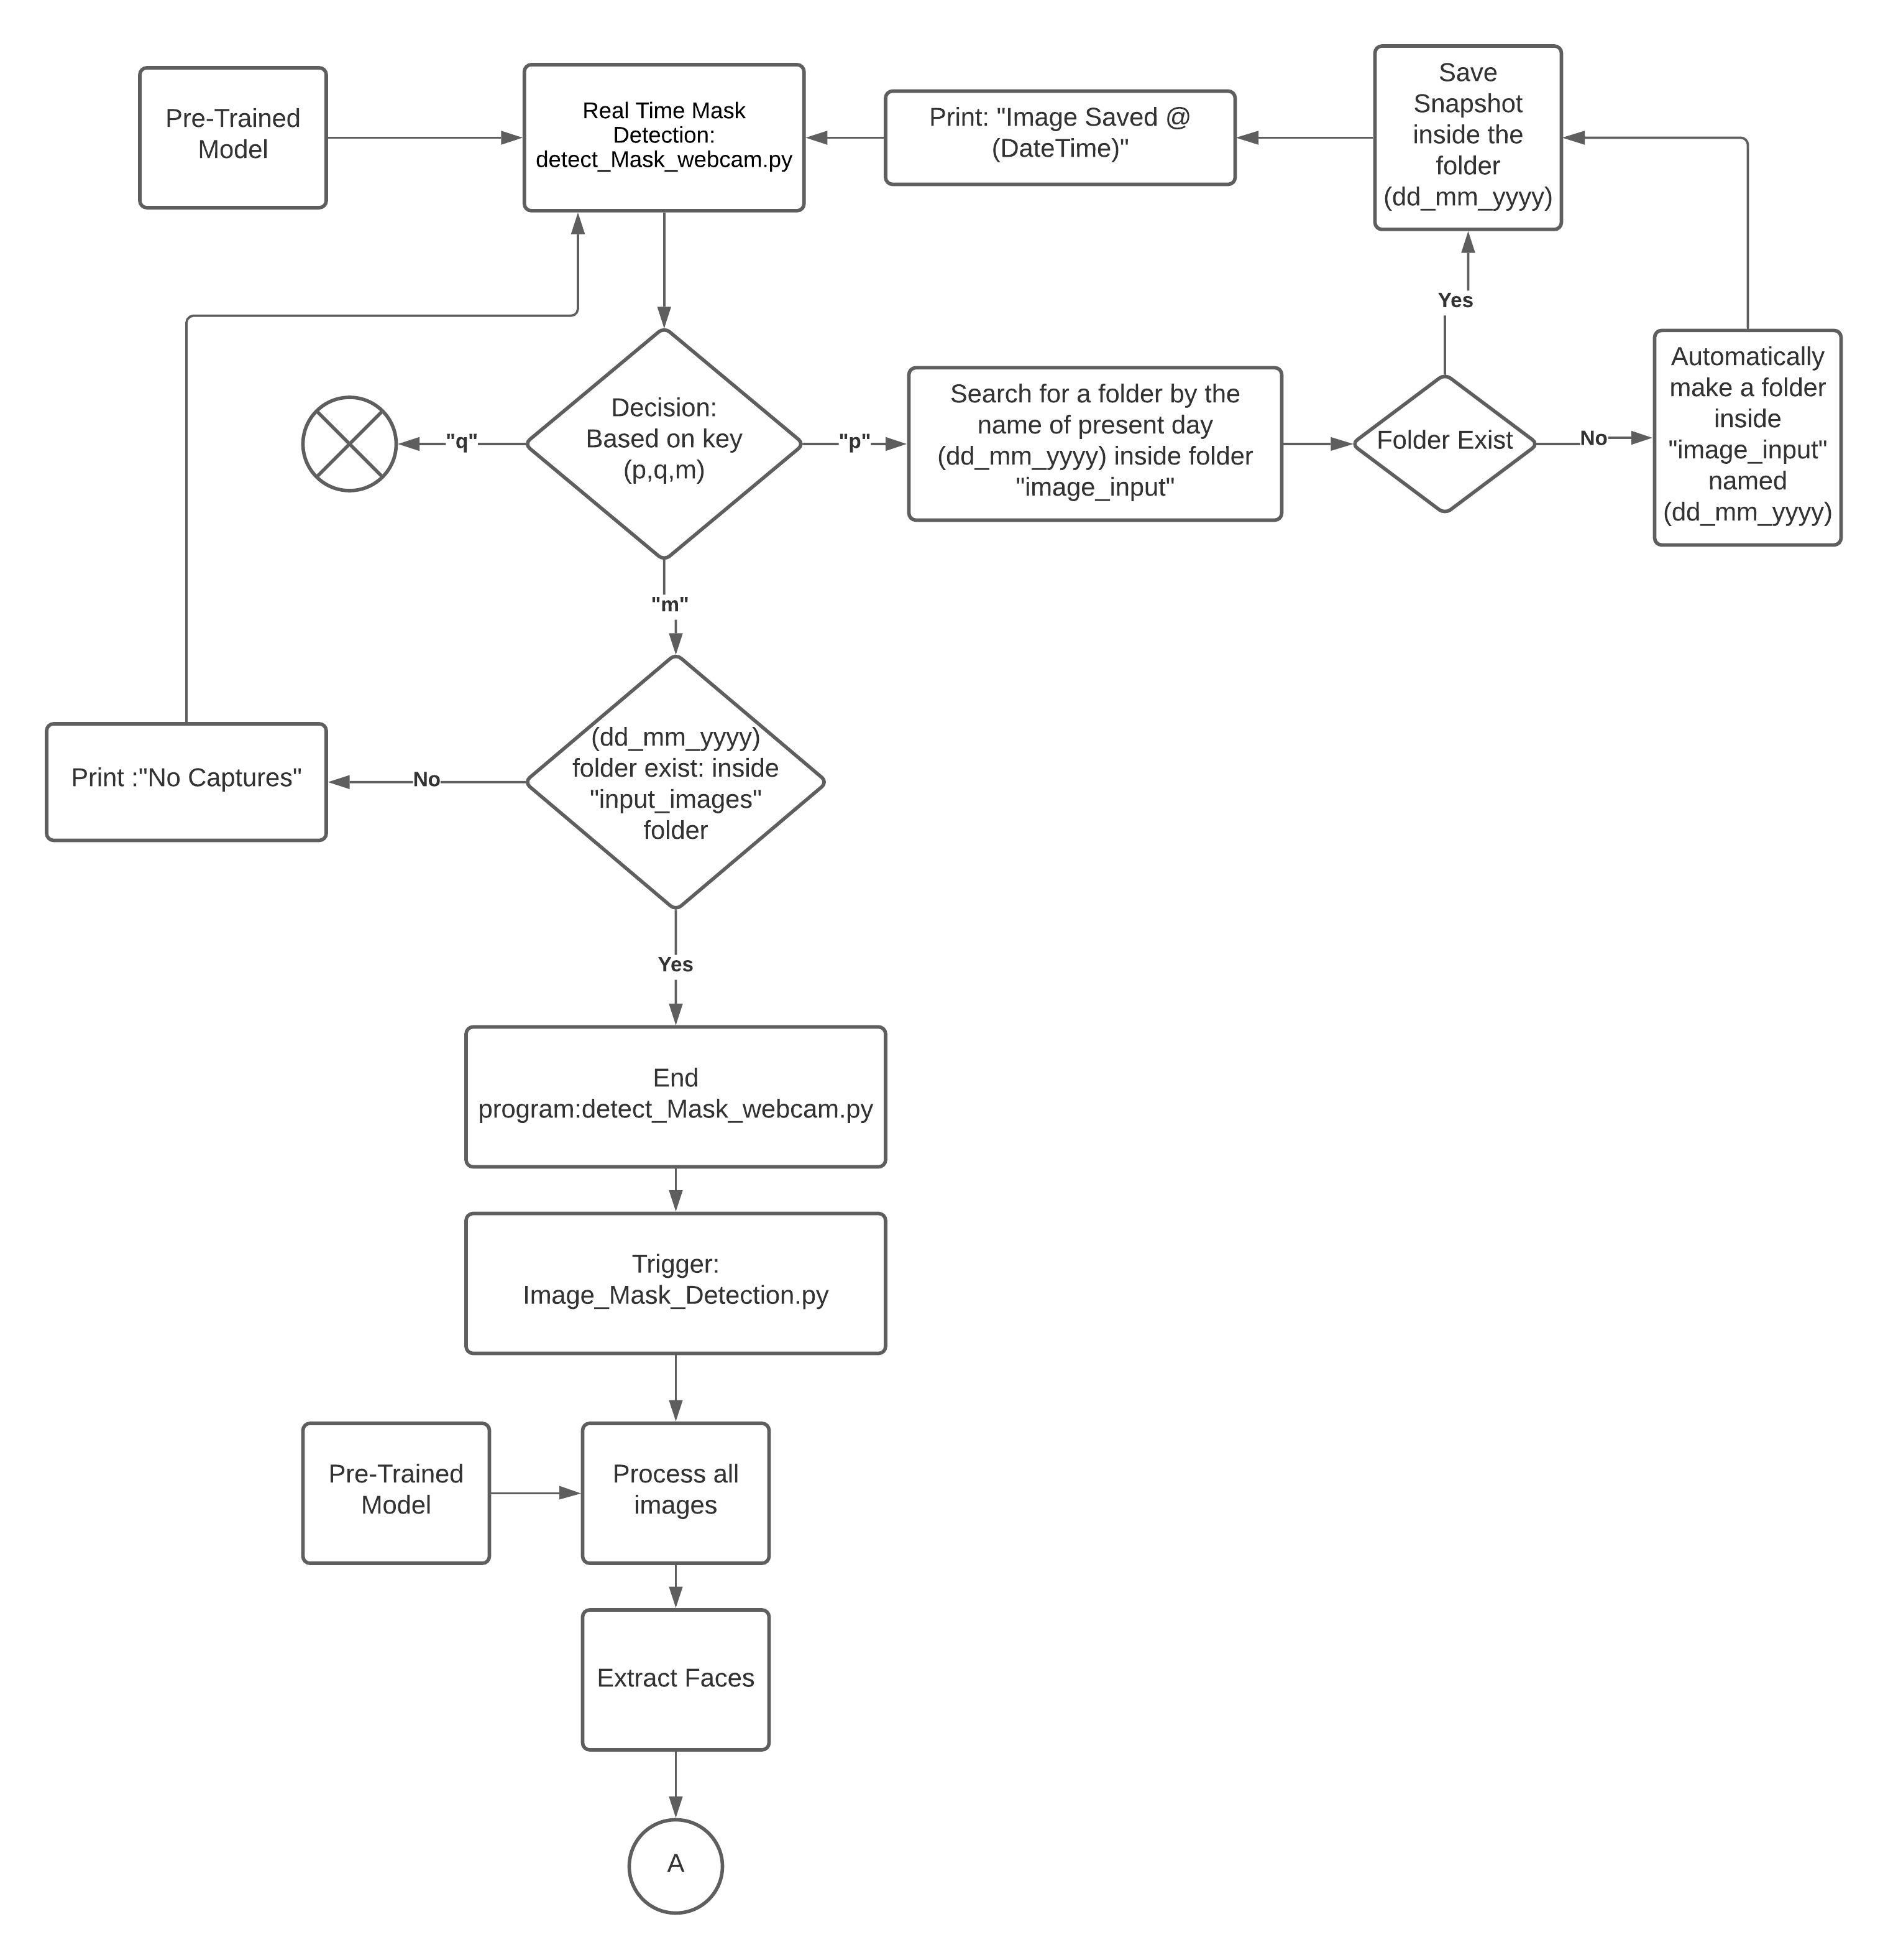
Flow Chart of Working process…

Slide 14
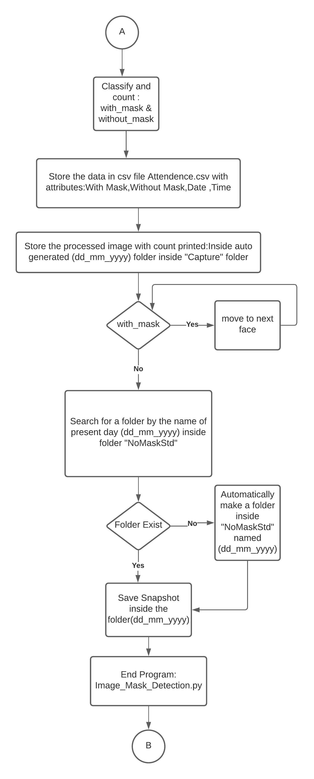

Slide 15
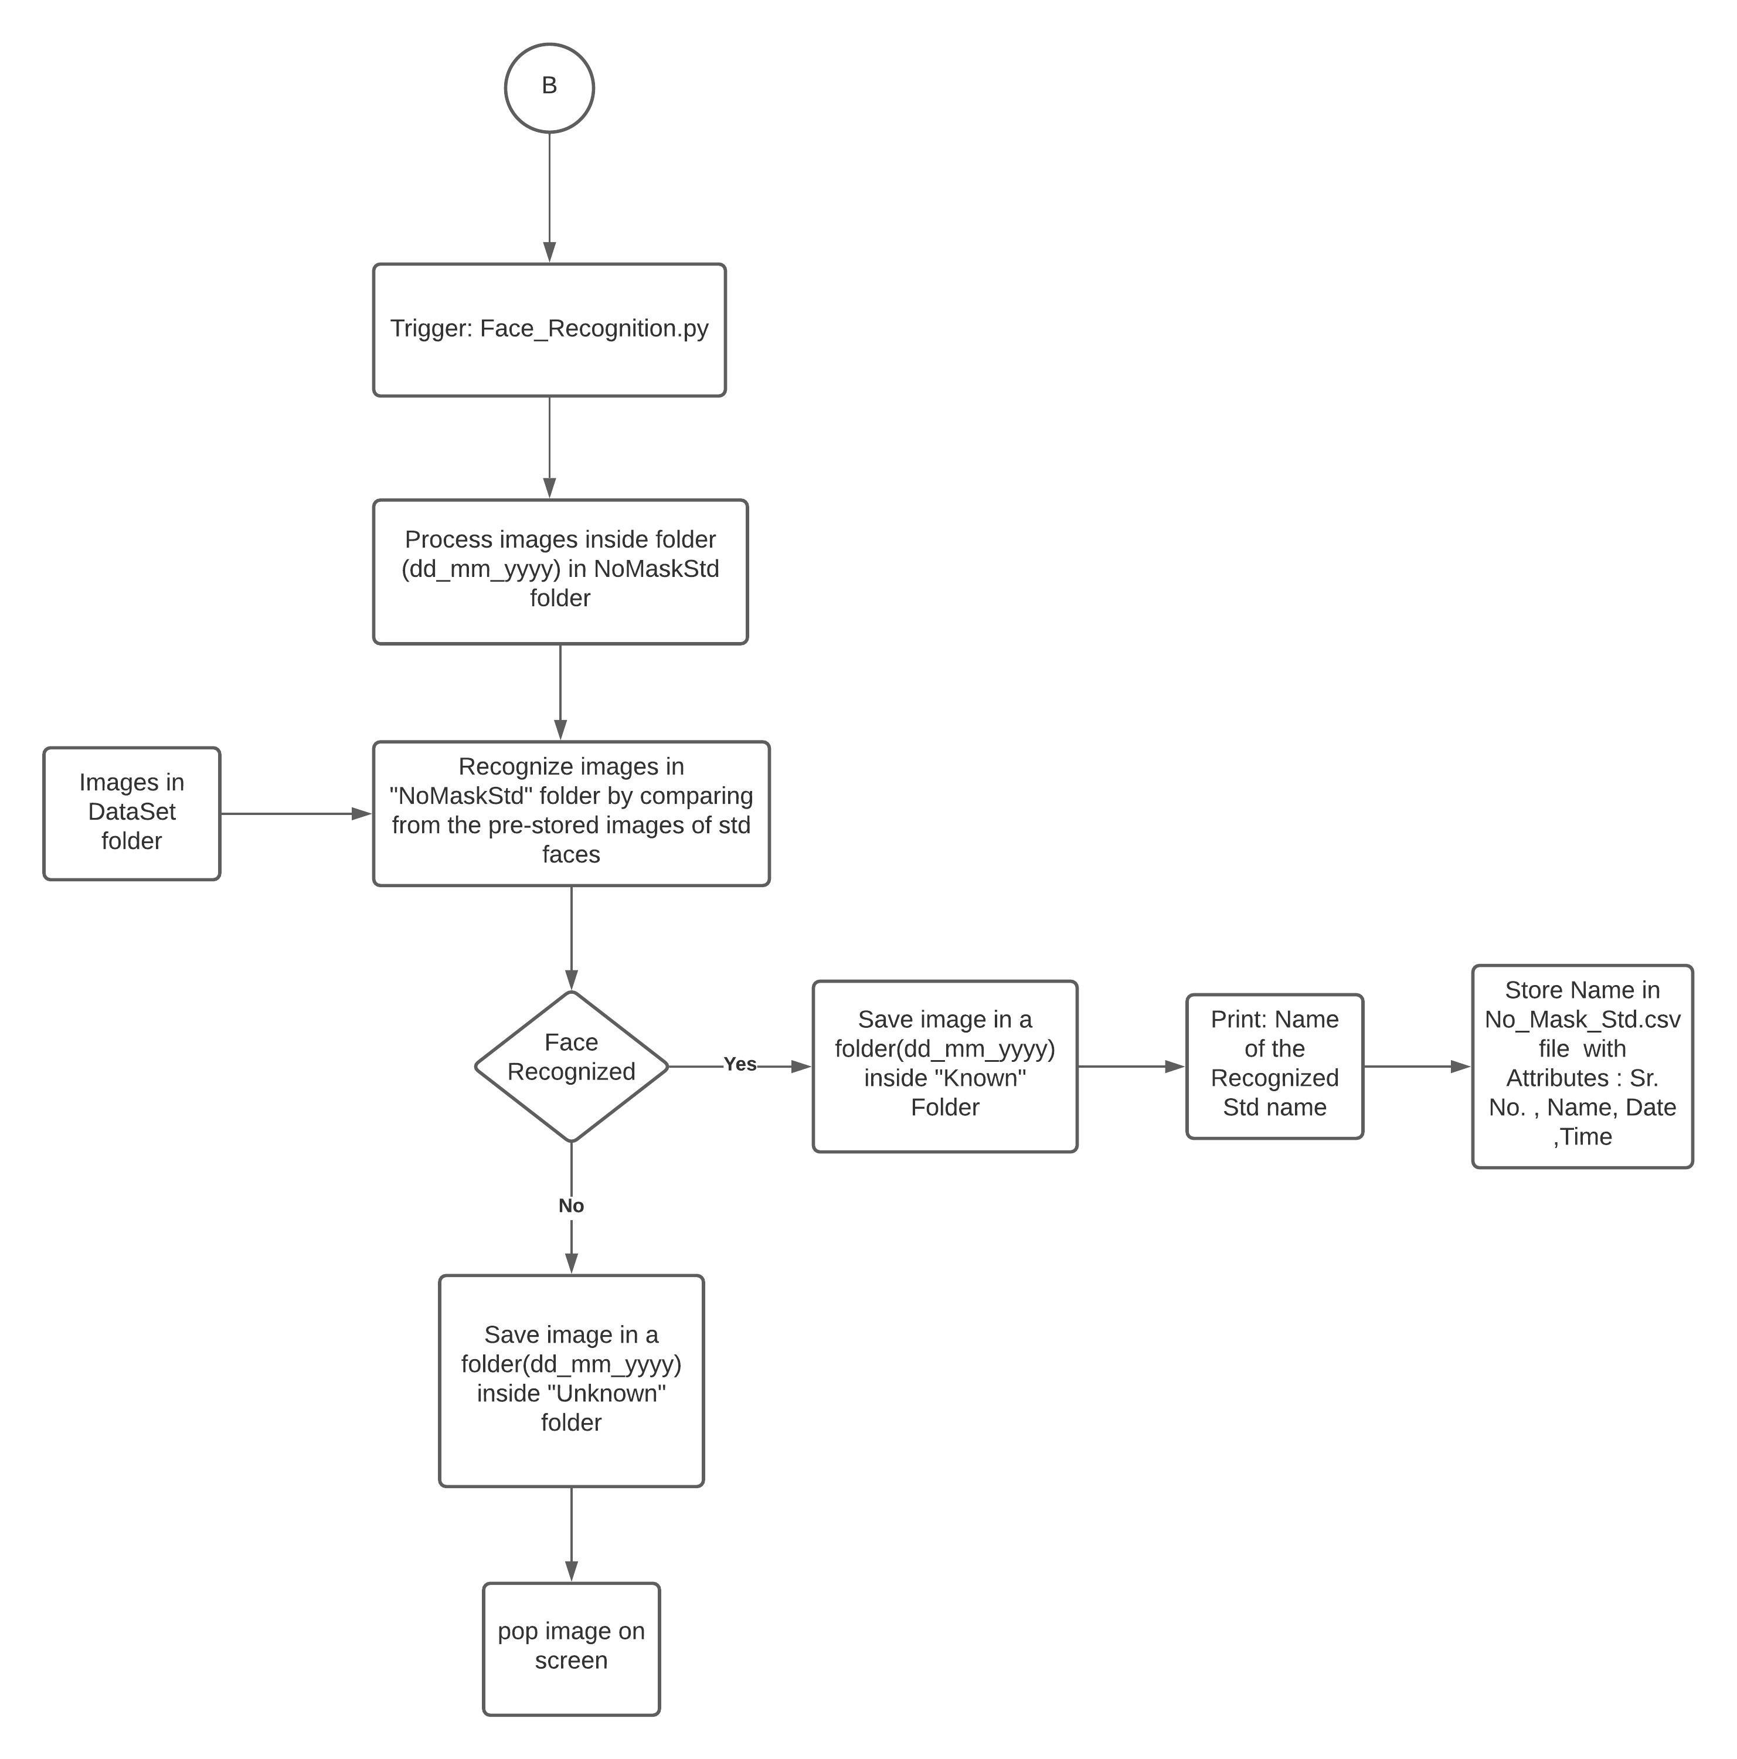

Slide 16

Output Image is saved in the following format…
Output Image →

Slide 17
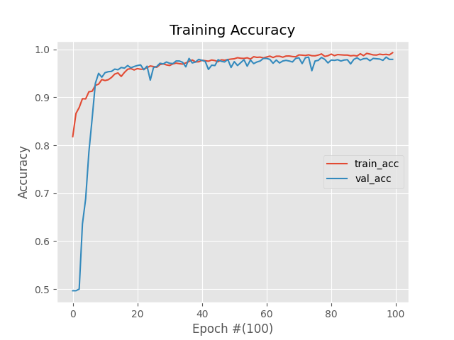
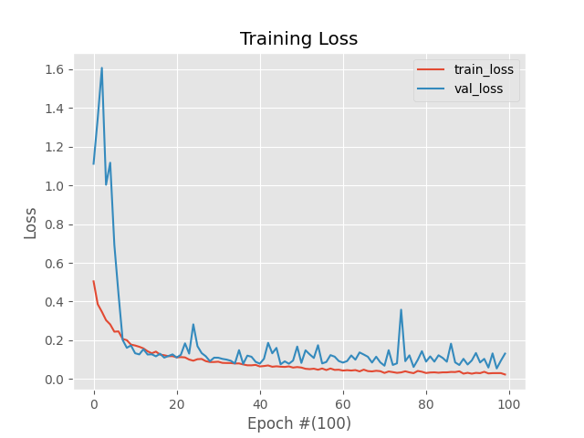
Training accuracy and loss

Slide 18
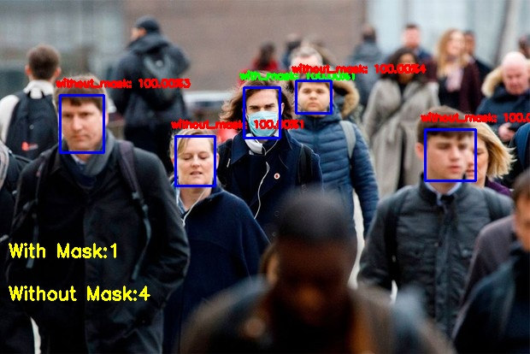
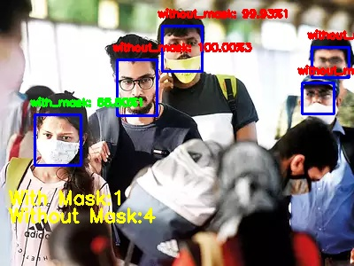
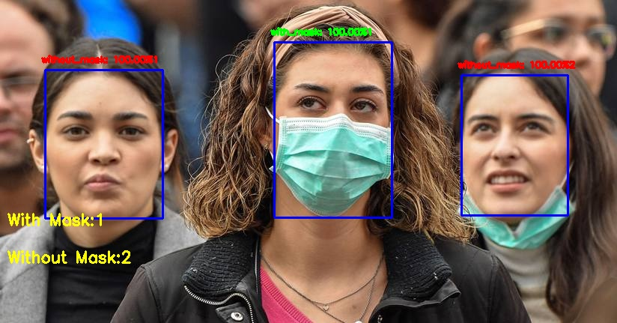

Slide 19

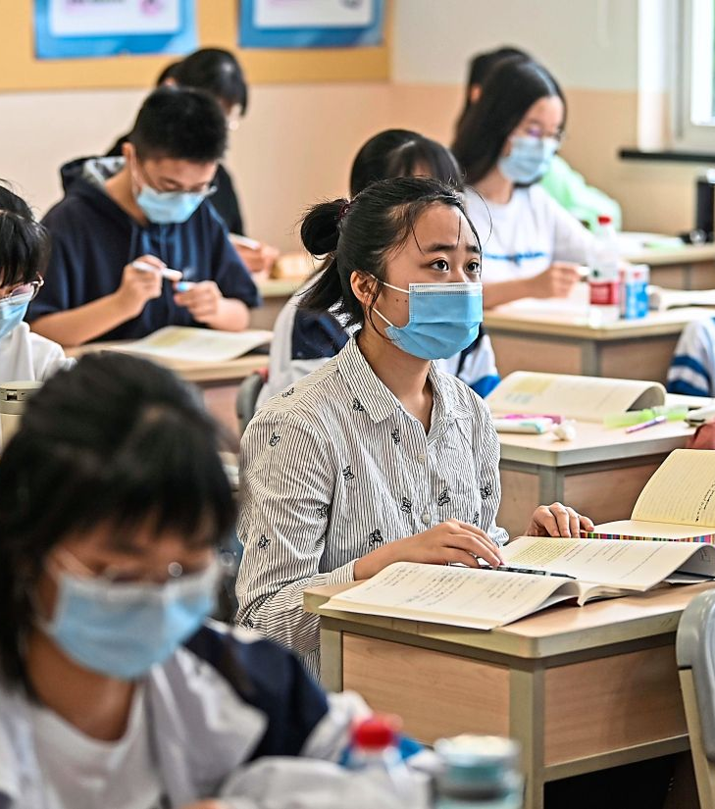
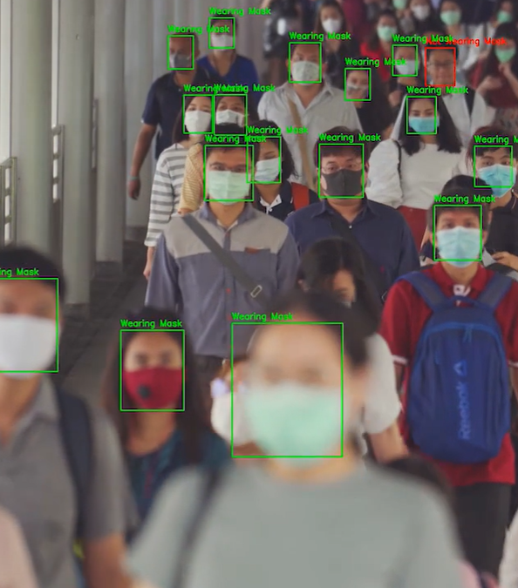

Slide 20
Libraries used:-
Tensorflow
Keras
imutils
numpy
opencv-contrib-python
matplotlib
scipy
pandas
DateTime
cvlib
face_recognition

Slide 21
References:-
Gaurav Kumar and Pradeep Kumar Bhatia. 2014. A Detailed Review of Feature Extraction in Image Processing Systems. In Proceedings of the 2014 Fourth International Conference on Advanced Computing &amp; Communication Technologies (ACCT '14). IEEE Computer Society, USA, 5–12. DOI:https://doi.org/10.1109/ACCT.2014.74
Leila Kabbai, Mehrez Abdellaoui, and Ali Douik. 2019. Image classification by combining local and global features. Vis. Comput.35, 5 (May 2019), 679–693. DOI:https://doi.org/10.1007/s00371-018-1503-03.
https://www.pathpartnertech.com/what-is-facial-recognition-technology-and-how-it-works/
https://towardsdatascience.com/face-recognition-for-beginners-a7a9bd5eb5c2
https://www.facefirst.com/blog/amazing-uses-for-face-recognition-facial-recognition-use-cases/

Slide 22
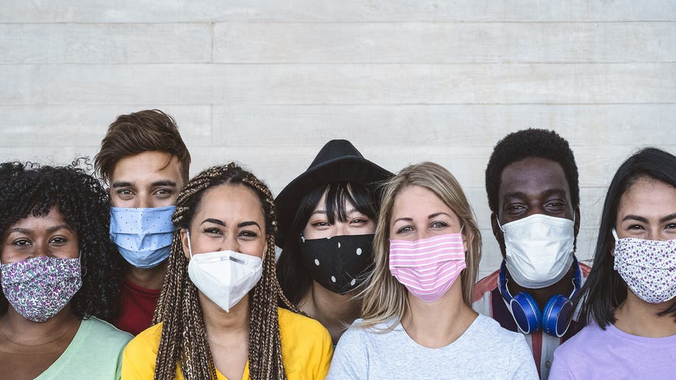
Thank You
Thank You ☺
.

